Slide 1

CS-M151B
Computer Systems Architecture
Blaise Tine
UCLA Computer Science

Slide 2

Attendance

Slide 3
Agenda
Caches

Slide 4
Improving Cache Performance
Improving Average Memory Access Time
AMAT = hit_time + miss_rate * miss_penalty
Reduce miss penalty
Reduce miss rate
Reduce hit time

Slide 5
MSHR
Track address, data, and status for outstanding cache misses
Provide correct memory ordering, other information (e.g, cache coherence)
Can be shared by multiple caches
Has fixed capacity: isfull check
CPU Pipeline
DCache
MSHR
Memory

Slide 6
Reducing Cache Miss Penalty
Multilevel caches
Very Fast, small Level 1 (L1) cache
Fast, not so small Level 2 (L2) cache
May also have slower, large L3 cache, etc.
Why does this help?
Miss in L1 cache can hit in L2 cache, etc.
AMAT = HitTime_{L1}+MissRate_{L1} x MissPenalty_{L1}
MissPenalty_{L1}= HitTime_{L2}+MissRate_{L2}x MissPenalty_{L2}
MissPenalty_{L2}= HitTime_{L3}+MissRate_{L3}x MissPenalty_{L3}

Slide 7
Reducing Cache Miss Penalty
Handling memory overlap with multi-level caches
Inclusion Property
If block A is in L1 cache, it must also be in L2 cache
Simpler data management (fill/eviction)
Exclusion Property
If block is in L1 cache, it is not in L2 cache
Higher total capacity => improved hit rate
Complex data management (fill/eviction)

Slide 8
Reducing Cache Miss Penalty
Exercise: Which is better?
Memory latency = 100 cycles
Single cache
16KB L1 cache, 3 cycle latency, 85% hit rate
Two-level of caching
Smaller 8KB cache: 1 cycle latency, 75% hit rate
Larger 128KB cache: 6 cycle latency, 60% hit rate

Slide 9
Reducing Cache Miss Penalty
Prioritizing memory transactions
Block transfer can take time if bus too narrow
Give data to loads before entire block arrive
Early restart
When needed word arrives, let processor use it
Then continue block transfer to fill cache line
Critical Word First
Transfer loaded word first, then the rest of block
Why this can be expensive?
Use with early restart to let processor go ASAP
Notes:
- Applicable to
- Critical word first will reorder the transfer

Slide 10
Reducing Cache Miss Penalty
Prioritize load misses
Loads can have dependent instructions
If a load misses and a store needs to go to memory, let the load miss go first
Use a write buffer to hold stores
Merge write requests
If multiple write misses to the same block, combine them in the write buffer
Use block-write instead of a many small writes
Notes:
- Applicable to
- Critical word first will reorder the transfer

Slide 11
Reducing Cache Miss Rate
Victim Caches
Recently evicted blocks are kept in small cache
If we miss on those blocks, can get them fast
Why does it work?
Exploit conflict misses
Example:
A 64KB direct-mapped L1 cache combined with a 1KB fully associative victim cache
Notes:
- Applicable to
- Critical word first will reorder the transfer

Slide 12
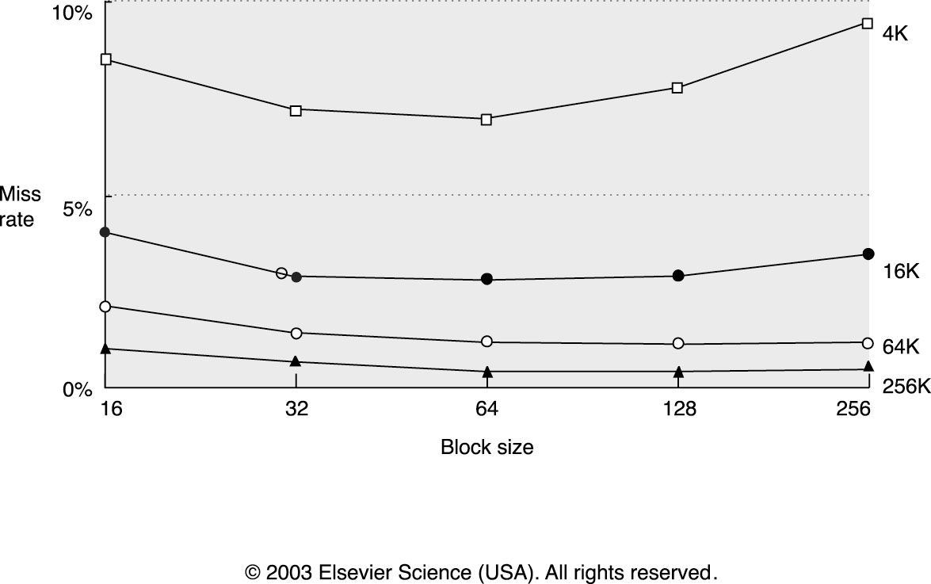
Reducing Cache Miss Rate
Larger blocks
Helps if there is more spatial locality
Cache size
Notes:
- Applicable to
- Critical word first will reorder the transfer

Slide 13
Reducing Cache Miss Rate
Larger capacity caches
Fewer capacity misses
But longer hit latency!
Higher associativity
Fewer conflict misses
But longer hit latency!
Which is better?
Need to work through AMAT equations to figure out
Notes:
- Applicable to
- Critical word first will reorder the transfer

Slide 14
Reducing Cache Miss Rate
Pseudo Associative Caches
Similar to way prediction
Start with direct mapped indexing
If miss on “primary” entry, try another entry
Use hash function to determine other indices to check
Results in varying access
Notes:
- Applicable to
- Critical word first will reorder the transfer

Slide 15
Reducing Cache Miss Rate
Compiler optimizations
Loop interchange
Blocking (e.g., tiled matrix multiplication)
Notes:
- Applicable to
- Critical word first will reorder the transfer

Slide 16
Loop Interchange Optimization
For loops over multi-dimensional arrays
Example: matrices (2-dim arrays)
Change order of iteration to match layout
Gets better spatial locality
Layout in C: last index changes first
for(j=0;j<10000;j++) for(i=0;i<40000;i++) c[i][j]=a[i][j]+b[i][j];
for(i=0;i<40000;i++) for(j=0;j<10000;j++) c[i][j]=a[i][j]+b[i][j];
a[i][j] and a[i+1][j] are 10000 elements apart
a[i][j] and a[i][j+1] are next to each other
Notes:
- Applicable to
- Critical word first will reorder the transfer

Slide 17
Blocking Optimization
Reduce the working set size.
To make the code fit into the cache
Example: 1D case
for (k = 0; k < N; k++) for (j=0; j<M; j++) if (X[j] == Y[k]) sum[k]++;
If one element in X is 4B and the total cache size is 1KB. 1KB/4B = 256 elements;
for (j=0; j<M/256; j++)
for (k = 0; k < N; k++)
for (i = 0; i< 256; i++)
if (X[j*256+i] == Y[k]) sum[k]++;
Notes:
- Increasing the reuse of X

Slide 18
Other software Optimization for caches
Data alignment
Increase spatial locality in cache block
aligned_malloc(addr, alignment);
Use Hint bits
Indicate temporal locality
Notes:
- Applicable to
- Critical word first will reorder the transfer

Slide 19
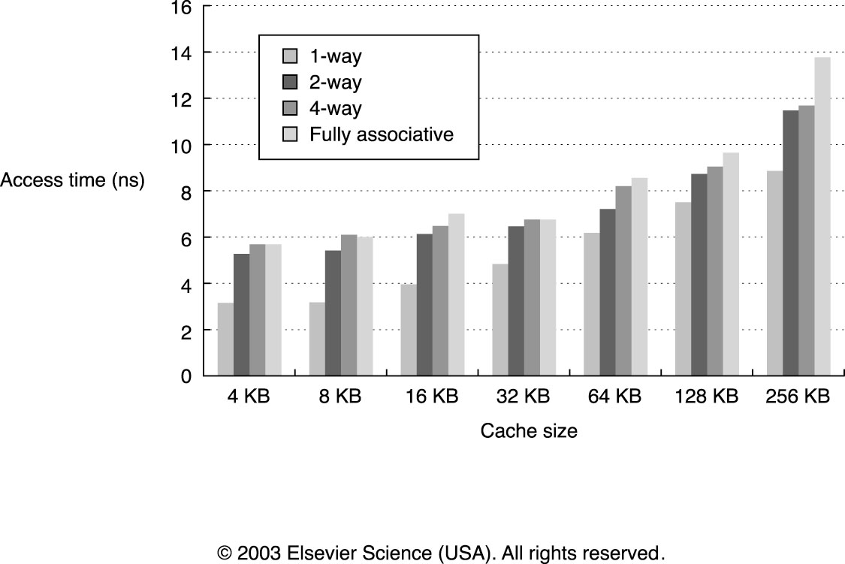
Reducing Hit Time
Small & Simple Caches are faster
What could be affecting access time?
Notes:
- Applicable to
- Critical word first will reorder the transfer

Slide 20
Reducing Hit Time
Pipelined Caches
Improves bandwidth, but not latency
Essential for L1 caches at high frequency
Even small caches have 2-3 cycle latency at N GHz
Multi-banked caches
Increases bandwidth and MLP
Trace Caches
Storing fetched and decoded instructions.
Way Prediction
Speeds up set-associative caches
Predict which of N ways has our data, fast access as direct-mapped cache
If mispredicted, access again as set-associative cache
Notes:
- Applicable to
- Critical word first will reorder the transfer

Slide 21
Virtual Memory

Slide 22
Running Multiple Programs
Early machines only run one program with unrestricted access to memory.
Program memory layout contained
code, data, heap, stack, etc..
I/O
STACK_BASE_ADDR
Stack
Dynamic
Data
TLS Data
Static Data
__global_pointer
Program
Nader Sehatbakhsh - ECE-M116C/CS-M151B - Fall 23

Slide 23
Running Multiple Programs
Modern systems need to run multiple applications concurrently.
User apps and OS
How do we run different programs in isolation on the same CPU?
Storing in different location
Enforcing memory security
Program 1
Program 2
Program 3
Main Memory
Nader Sehatbakhsh - ECE-M116C/CS-M151B - Fall 23

Slide 24
Running Multiple Programs
How do we run different programs in isolation on the same CPU?
Each program address layout
code, data, heap, stack, etc..
Portion of the memory is shared (e.g. libraries)
Portion of the memory is reserved for OS services
Program 1
Program 2
Program 3
Main Memory
Nader Sehatbakhsh - ECE-M116C/CS-M151B - Fall 23

Slide 25
Sharing memory between applications
Static Partitioning
Features
Protection
Applications shouldn’t be able to access other user memory
Use bound checking
Location-independence
Applications can be allocated anywhere in memory
Use base pointer
Program 1
Program 2
Program 3
Main Memory

Slide 26


Sharing memory between applications
Static Partitioning address translation
PhysicalAddr = BaseReg + LogicalAddr
Bound check before translation!
Program X
Physical Memory
≥
Bounds Violation?
Bound Reg.
(from CPU)
Logical Address
+
Physical Address
Base Reg.
Base Physical Address
Nader Sehatbakhsh - ECE-M116C/CS-M151B - Fall 23

Slide 27

Sharing memory between applications
Static Partitioning Limitations
Not able to share libraries
What if pre-allocated program needs more space?
Library
Program 1
Program 2
OS
Main Memory
Nader Sehatbakhsh - ECE-M116C/CS-M151B - Fall 23

Slide 28
Sharing memory between applications
1
0
1
3
3
2
0
0
2
2
3
1
Operating
System
Pages
Dynamic Partitioning (Virtual Memory)
Divide memory into fixed-size blocks called pages
Assign pages to each program as needed
Pages can be scattered in memory
Each page is typically 4 KB
Main Memory
0
1
2
3
0
1
2
3
0
1
2
3
Program A
Program B
Program C
Nader Sehatbakhsh - ECE-M116C/CS-M151B - Fall 23

Slide 29
Virtual Memory
1
0
1
3
3
2
0
0
2
2
3
1
Operating
System
Pages
How we track pages mapping?
We use a page table
Main Memory
0
1
2
3
0
1
2
3
p0
p1
p2
p3
Nader Sehatbakhsh - ECE-M116C/CS-M151B - Fall 23

Slide 30
Virtual Memory
Program A
Virtual Space
Program B Virtual Space
Virtual to physical address translation
Each program sees a uniform virtual address space
Reserv.
Code
Data
Heap
Stack
Reserv.
Code
Data
Heap
Stack
v0
v1
p0
p1
Physical Memory
₂32
Nader Sehatbakhsh - ECE-M116C/CS-M151B - Fall 23

Slide 31
Virtual Address Translation
virtual address
p p–1
n–1
0
virtual page number (VPN) page offset
2^{n}: virtual address size
2^{m}: physical address size
2^{p}: page size
address translation
m–1
p p–1
0
physical page number (PPN) page offset
physical address
Nader Sehatbakhsh - ECE-M116C/CS-M151B - Fall 23

Slide 32
Virtual and Physical Memory
System:
Virtual memory size: 4 GB = 2³² bytes
Physical memory size: 256 MB = 2²⁸ bytes
Page size: 4 KB = 2¹² bytes
Organization:
Virtual address: 32 bits
Physical address: 28 bits
Page offset: 12 bits
# Virtual pages = 2³²/2¹² = 2²⁰ (VPN = 20 bits)
# Physical pages = 2²⁸/2¹² = 2¹⁶ (PPN = 16 bits)
Nader Sehatbakhsh - ECE-M116C/CS-M151B - Fall 23

Slide 33
Page Table
n–1
p p–1
0
page table base register (per process)
virtual page number (VPN) page offset
physical page number (PPN)
VPN acts as table index
m–1
p p–1
0
physical page number (PPN)
physical address
page offset
Nader Sehatbakhsh - ECE-M116C/CS-M151B - Fall 23

Slide 34
Page Table
Page table base register
Physical base address of the page table in memory (per process)
Effective method for swapping to another process memory
Set by memory management unit (MMU) during context switch
On RISC-V, this is done via satp CSRs
Nader Sehatbakhsh - ECE-M116C/CS-M151B - Fall 23

Slide 35
Page Table
What is store in the page table
Physical address mapping
Flags
Valid bit
Accessed bit
Dirty bit
Permission bits (R/W/E)
Protection bits (User/Supervisor)
etc…
Flags Physical page number (PPN)
Nader Sehatbakhsh - ECE-M116C/CS-M151B - Fall 23

Slide 36
Page Table
Where is the page table stored?
In memory as well
Each memory access is two transactions:
Accessing page table:
PPN = Memory[base + VPN]
Accessing the translated address
Value = Memory[PPN + page_offset]
Nader Sehatbakhsh - ECE-M116C/CS-M151B - Fall 23

Slide 37
Page Table
How large is a page table?
# Virtual pages = 2³²/2¹² = 2²⁰ (VPN = 20 bits)
Each page table entry (PTE) size = PPN+flags ≃ 32 bits (4 bytes)
2²⁰ x 32 = 4 MB for each application!
Much larger for 64-bit address!
Need to compress the table
Nader Sehatbakhsh - ECE-M116C/CS-M151B - Fall 23

Slide 38
Hierarchical Page Table
Store the page table as a page table
Level 1 Page Table
Physical Memory
offset
p2
Base pointer
p1
Virtual Address
31 22 21 12 11
0
Page Walk!
p1 | p2 | offset
Level 2 Page Tables
L1 index
L2 index
Nader Sehatbakhsh - ECE-M116C/CS-M151B - Fall 23

Slide 39
Hierarchical Page Table
Instead of one large table, we have a small p1-entries page directory and we allocate p2-entries table on demand
Total allocated table size:
Given p1=10-bit, p2=10-bit
Size = (1k * 4B) + 1k * (1k * 4B) > 4 MB
Virtual Address
31 22 21 12 11
p1 | p2 | offset
L1 index
L2 index
Nader Sehatbakhsh - ECE-M116C/CS-M151B - Fall 23

Slide 40
Hierarchical Page Table
Longer memory access transaction
Directory: base2 = Memory[base + p1]
Page Table: PPN = Memory[base2 + p2]
Translation: value =Memory[PPN + page_offset]
Expensive!
Virtual Address
31 22 21 12 11
p1 | p2 | offset
L1 index
L2 index
Nader Sehatbakhsh - ECE-M116C/CS-M151B - Fall 23

Slide 41
Translation Lookaside Buffer (TLB)
CPU
 | Regs
Store most recent translations into a cache (TLB)
TLB
MMU
Miss?
Hit?
I$
D$
PT
L2, L3
Main Memory
PA (to cache)
Nader Sehatbakhsh - ECE-M116C/CS-M151B - Fall 23

Slide 42
Translation Lookaside Buffer (TLB)
Cache translations in TLB
TLB hit ⇒ Single-Cycle Translation
TLB miss ⇒ Page-Table Walk to refill
TLB is flushed during context switch (avoidable with tagged PID)
virtual address
VPN
offset
tag
PPN
hit?
physical address
PPN
offset
Nader Sehatbakhsh - ECE-M116C/CS-M151B - Fall 23

Slide 43
Translation Lookaside Buffer (TLB)
TLB Design
32-128 entries fully associative
256-512 entries are 4/8 way set associative
Random or FIFO replacement policy
virtual address
VPN
offset
tag
PPN
hit?
physical address
PPN
offset
Nader Sehatbakhsh - ECE-M116C/CS-M151B - Fall 23

Slide 44
Reducing Virtual Memory Access Time
Memory addresses to L1 are virtual
Hit time = t_{TLB} + t_{L1cache}
Possible optimization?
virtual address
VPN
offset
tag
PPN
hit?
physical address
PPN
offset
Nader Sehatbakhsh - ECE-M116C/CS-M151B - Fall 23

Slide 45
Reducing Virtual Memory Access Time
Virtually-Indexed Physically-Tagged Cache
Hit time = max(t_{TLB,}t_{L1cache})
VPN
Page Offset
Index Offset
physical Cache (L1)
TLB
TLB hit?
PPN
=
tag
data
cache hit?
Nader Sehatbakhsh - ECE-M116C/CS-M151B - Fall 23

Slide 46
Q&A

Slide 47
Acknowledgement
This course is partly inspired and use materials from the following courses created by my colleagues:
ECE-M1126C: Nader Sehatbakhsh @ UCLA
CS3220: Hyesoon Kim @ gatech

